Slide 1


Jason Forsythe
7/14/22

Slide 2

Outline
Executive Summary
Introduction
Methodology
Results
Conclusion
Appendix

Slide 3
Executive Summary
Summary of methodologies
Summary of all results

Slide 4
Introduction
In this project I wanted to find out the answers to a few questions
Can I predict the success of a SpaceX first stage landing?
If so, what parameters could be used to give the best prediction?
What would be the best accuracy of prediction that I could achieve?

Slide 5

Section 1

Slide 6
Methodology
Executive Summary
Data collection methodology:
Data was collected via SpaceX API and Web Scraping https://github.com/Jason-AE/IBM_Data_Science/tree/master/DataCollectionAPI
Perform data wrangling
Once Data was collected, I removed unesseary columns and replaced null values. https://github.com/Jason-AE/IBM_Data_Science/tree/master/DataWrangling
Perform exploratory data analysis (EDA) using visualization and SQL
Perform interactive visual analytics using Folium and Plotly Dash
Perform predictive analysis using classification models
I tested Logistic Regression, Vector Machine, Tree, and K Nearest Neighbor models using grid search to find the best parameters for each. I then compared the results using test data and the Tree model performed the best. https://github.com/Jason-AE/IBM_Data_Science/tree/master/PredictiveAnalysis

Slide 7
Data Collection – SpaceX API
Data was collected using SpaceX’s own Web API
https://api.spacexdata.com/v4/launches/past
This data was used along with different endpoints to combine data about the rockets, launchpads, payloads, and cores.
The Data was then stored in a Panda’s Data Frame
Rockets
Pandas Dataframe
Past Launches
Launchpads
Payloads
Cores
https://github.com/Jason-AE/IBM_Data_Science/tree/master/DataCollectionAPI

Slide 8
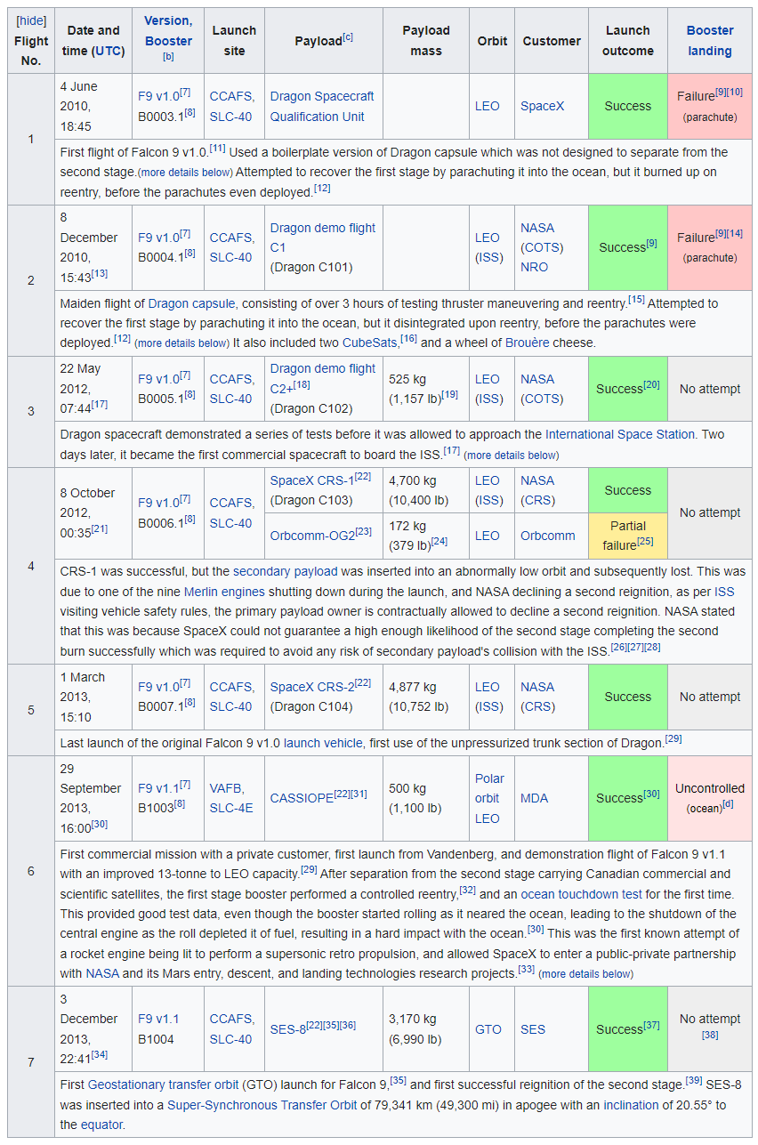
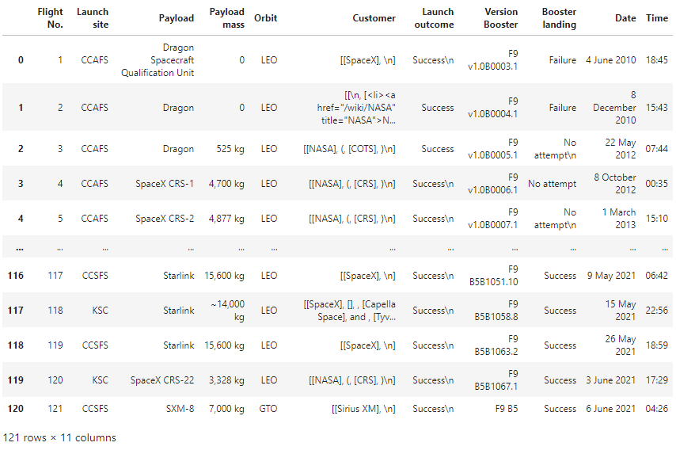
Data Collection - Scraping
Data was also collected using Web scrapping using Wikipedia data in HTML Tables https://en.wikipedia.org/w/index.php?title=List_of_Falcon_9_and_Falcon_Heavy_launches&oldid=1027686922
BeautifulSoup Library Was Used to Extract Data
Helper functions cleaned the HTML
Pandas Dataframe was created
Iterations over the rows was used to fill Dataframe
Resulting Pandas Dataframe
HTML Table Example
https://github.com/Jason-AE/IBM_Data_Science/tree/master/DataCollectionAPI

Slide 9
Data Wrangling
Once data was collected it needs to be cleaned
Check for missing values in each attribute (~40 in LandingPad)
Replace missing values with mean in that column or remove rows
Convert landing outcomes to a class of either 0 failed 1 success
Now we can check the mean of success (66.666%)
This clean up is important for normalization and predictive analytics (to be preformed later)
https://github.com/Jason-AE/IBM_Data_Science/tree/master/DataWrangling

Slide 10
EDA with Data Visualization
In Exploratory Data Analysis I plotted the following charts:
Success rate vs launch site: to determine if launch site affects success
Flight number per site vs success rate: to determine if launches were more successful with later launches.
Payload per site vs success rate: to determine if payload affects success rate at each site
Success rate vs orbit type: to determine if orbit affects success rate
Payload by orbit type vs success rate: to determine if certain payloads in a give orbit affect success rate
Success rate over time (yearly): to determine if success increased over time
https://github.com/Jason-AE/IBM_Data_Science/tree/master/EDA

Slide 11
EDA with SQL
In exploratory data analysis using SQL I performed the following queries:
Select distinct launch site names
Displayed 5 records from the data set where the launch site contained ‘KSC’
Displayed the total payload carried for NASA missions
Displayed the average payload carried by booster version F9 v1.1
Showed the date of the first successful landing on a drone ship
Listed the names of the boosters that have had successful landings on land with a mass greater than 4000 and less that 6000 kg
Listed the total number of successful and failure mission outcomes
Listed the booster versions that have carried the maximum payload mass
For 2017 listed the booster versions and launch sites for successful landings on land
Ranked the count of successful landings between 2010-06-04 and 2017-03-20 in descending order
https://github.com/Jason-AE/IBM_Data_Science/tree/master/EDA

Slide 12
Build an Interactive Map with Folium
Summarize what map objects such as markers, circles, lines, etc. you created and added to a folium map
Explain why you added those objects
Add the GitHub URL of your completed interactive map with Folium map, as an external reference and peer-review purpose

Slide 13
Build a Dashboard with Plotly Dash
Summarize what plots/graphs and interactions you have added to a dashboard
Explain why you added those plots and interactions
Add the GitHub URL of your completed Plotly Dash lab, as an external reference and peer-review purpose

Slide 14
Predictive Analysis (Classification)
Summarize how you built, evaluated, improved, and found the best performing classification model
You need present your model development process using key phrases and flowchart
Add the GitHub URL of your completed predictive analysis lab, as an external reference and peer-review purpose

Slide 15
Results
Exploratory data analysis results
Interactive analytics demo in screenshots
Predictive analysis results

Slide 16

Section 2

Slide 17
Flight Number vs. Launch Site
Show a scatter plot of Flight Number vs. Launch Site
Show the screenshot of the scatter plot with explanations

Slide 18
Payload vs. Launch Site
Show a scatter plot of Payload vs. Launch Site
Show the screenshot of the scatter plot with explanations

Slide 19
Success Rate vs. Orbit Type
Show a bar chart for the success rate of each orbit type
Show the screenshot of the scatter plot with explanations

Slide 20
Flight Number vs. Orbit Type
Show a scatter point of Flight number vs. Orbit type
Show the screenshot of the scatter plot with explanations

Slide 21
Payload vs. Orbit Type
Show a scatter point of payload vs. orbit type
Show the screenshot of the scatter plot with explanations

Slide 22
Launch Success Yearly Trend
Show a line chart of yearly average success rate
Show the screenshot of the scatter plot with explanations

Slide 23
All Launch Site Names
Find the names of the unique launch sites
Present your query result with a short explanation here

Slide 24
Launch Site Names Begin with 'KSC'
Find 5 records where launch sites’ names start with `KSC`
Present your query result with a short explanation here

Slide 25
Total Payload Mass
Calculate the total payload carried by boosters from NASA
Present your query result with a short explanation here

Slide 26
Average Payload Mass by F9 v1.1
Calculate the average payload mass carried by booster version F9 v1.1
Present your query result with a short explanation here

Slide 27
First Successful Ground Landing Date
Find the dates of the first successful landing outcome on drone ship.Present your query result with a short explanation here

Slide 28
Successful Drone Ship Landing with Payload between 4000 and 6000
List the names of boosters which have successfully landed on drone ship and had payload mass greater than 4000 but less than 6000
Present your query result with a short explanation here

Slide 29
Total Number of Successful and Failure Mission Outcomes
Calculate the total number of successful and failure mission outcomes
Present your query result with a short explanation here

Slide 30
Boosters Carried Maximum Payload
List the names of the booster which have carried the maximum payload mass
Present your query result with a short explanation here

Slide 31
2015 Launch Records
List the records which will display the month names, succesful landing_outcomes in ground pad ,booster versions, launch_site for the months in year 2017
Present your query result with a short explanation here

Slide 32
Rank Landing Outcomes Between 2010-06-04 and 2017-03-20
Rank the count of successful landing_outcomes between the date 2010-06-04 and 2017-03-20 in descending order
Present your query result with a short explanation here

Slide 33

Section 3

Slide 34
<Folium Map Screenshot 1>
Replace <Folium map screenshot 1> title with an appropriate title
Explore the generated folium map and make a proper screenshot to include all launch sites’ location markers on a global map
Explain the important elements and findings on the screenshot

Slide 35
<Folium Map Screenshot 2>
Replace <Folium map screenshot 2> title with an appropriate title
Explore the folium map and make a proper screenshot to show the color-labeled launch outcomes on the map
Explain the important elements and findings on the screenshot

Slide 36
<Folium Map Screenshot 3>
Replace <Folium map screenshot 3> title with an appropriate title
Explore the generated folium map and show the screenshot of a selected launch site to its proximities such as railway, highway, coastline, with distance calculated and displayed
Explain the important elements and findings on the screenshot

Slide 37

Section 4

Slide 38
<Dashboard Screenshot 1>
Replace <Dashboard screenshot 1> title with an appropriate title
Show the screenshot of launch success count for all sites, in a piechart
Explain the important elements and findings on the screenshot

Slide 39
<Dashboard Screenshot 2>
Replace <Dashboard screenshot 2> title with an appropriate title
Show the screenshot of the piechart for the launch site with highest launch success ratio
Explain the important elements and findings on the screenshot

Slide 40
<Dashboard Screenshot 3>
Replace <Dashboard screenshot 3> title with an appropriate title
Show screenshots of Payload vs. Launch Outcome scatter plot for all sites, with different payload selected in the range slider
Explain the important elements and findings on the screenshot, such as which payload range or booster version have the largest success rate, etc.

Slide 41

Section 5

Slide 42
Classification Accuracy
Visualize the built model accuracy for all built classification models, in a bar chart
Find which model has the highest classification accuracy

Slide 43
Confusion Matrix
Show the confusion matrix of the best performing model with an explanation

Slide 44
Conclusions
Point 1
Point 2
Point 3
Point 4
…

Slide 45
Appendix
Include any relevant assets like Python code snippets, SQL queries, charts, Notebook outputs, or data sets that you may have created during this project

Slide 46


